Slide 1
Credit EDA Case Study
Manoj Patil
Rittik Saha

Slide 2
Data cleaning and imputation
Total no of columns with missing values more than 50% : 41
Action taken: Deleted columns from Dataset
Total no of columns with missing values less than 15% : 16
Action taken: Data imputation
Total number of columns we have imputed data: 16
Data imputation methods used
For categorical variables: Used value with highest frequency
For numeric variables: Used mean/median value as per the data
Data cleaning and formatting
Changed data type from float to integer for discrete variables
For day fields changed negatives values to absolute values
For employment days data changed default values to null values

Slide 3
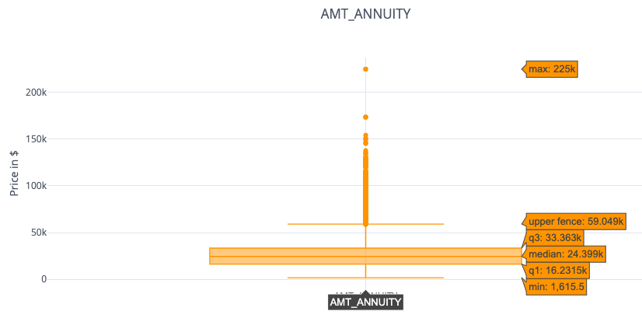
Outlier detection & analysis
Outlier analysis: Outlier analysis done for below columns
AMT_INCOME_TOTAL
Lower bound for outliers : -22500.0 & Upper bound : 337500.0
Total no of outliers for column AMT_INCOME_TOTAL : 14035
AMT_ANNUITY
Lower bound for outliers : -9465.75 & Upper bound : 59060.25
Total no of outliers for column AMT_ANNUITY : 6250
AMT_GOODS_PRICE
Lower bound for outliers : -438750.0 & Upper bound : 1343250.0
Total no of outliers for column AMT_GOODS_PRICE : 8797
CNT_FAM_MEMBERS
Lower bound for outliers : 0.0 & Upper bound : 4
Total no of outliers for column CNT_FAM_MEMBERS : 3579
Action Taken: Deleted the outlier records from the dataset

Slide 4
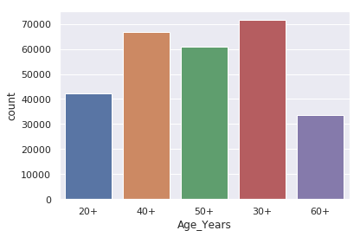
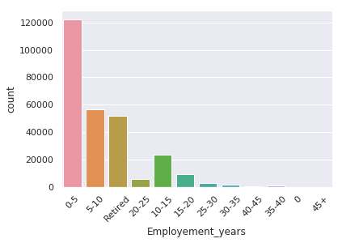
Binning (Numeric to Categorical)
For Age and employment days data we
have done binning to convert that data into categorical data for further analysis

Slide 5
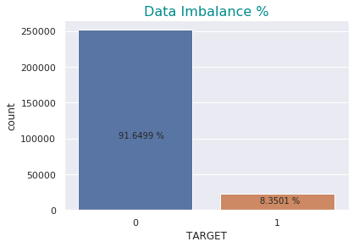
Data imbalance
The data after cleanup is highly imbalanced with around 8.35% data for loan defaulters (TARGET = 1) and remaining 91.65% data for non-defaulters.
A data-sampling technique can be used to do over sampling/under sampling which can reduce the bias introduced due to data imbalance

Slide 6
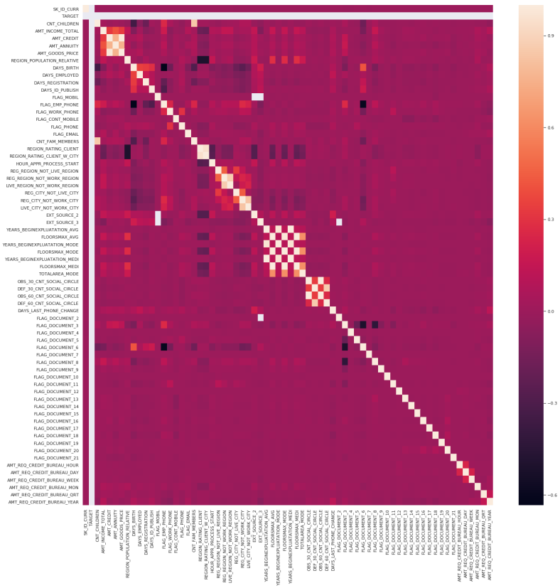
Positive correlation
Top 10 list of positive correlations between variables
Correlation diagram for Target = 0
Variable 1 | Variable 2 | Correlation for TARGET = 0 | Correlation for TARGET = 1
OBS_60_CNT_SOCIAL_CIRCLE | OBS_30_CNT_SOCIAL_CIRCLE | 0.998518 | 0.998223
FLOORSMAX_AVG | FLOORSMAX_MEDI | 0.997127 | 0.997275
YEARS_BEGINEXPLUATATION_MEDI | YEARS_BEGINEXPLUATATION_AVG | 0.993679 | 0.996793
FLOORSMAX_MODE | FLOORSMAX_MEDI | 0.988479 | 0.989553
FLOORSMAX_AVG | FLOORSMAX_MODE | 0.985978 | 0.986756
AMT_GOODS_PRICE | AMT_CREDIT | 0.981619 | 0.977604
YEARS_BEGINEXPLUATATION_MODE | YEARS_BEGINEXPLUATATION_AVG | 0.972117 | 0.981389
YEARS_BEGINEXPLUATATION_MEDI | YEARS_BEGINEXPLUATATION_MODE | 0.963316 | 0.977934
REGION_RATING_CLIENT | REGION_RATING_CLIENT_W_CITY | 0.950646 | 0.959696
DEF_60_CNT_SOCIAL_CIRCLE | DEF_30_CNT_SOCIAL_CIRCLE | 0.861389 | 0.870284
Top 10 correlations between variables are in the range of 0.861 - 0.998. and both datasets(defaulter and non-defaulter) have similar correlation.
All the variables with top 10 correlations are matching in both datasets with their correlation varying within 0.01 scale.

Slide 7
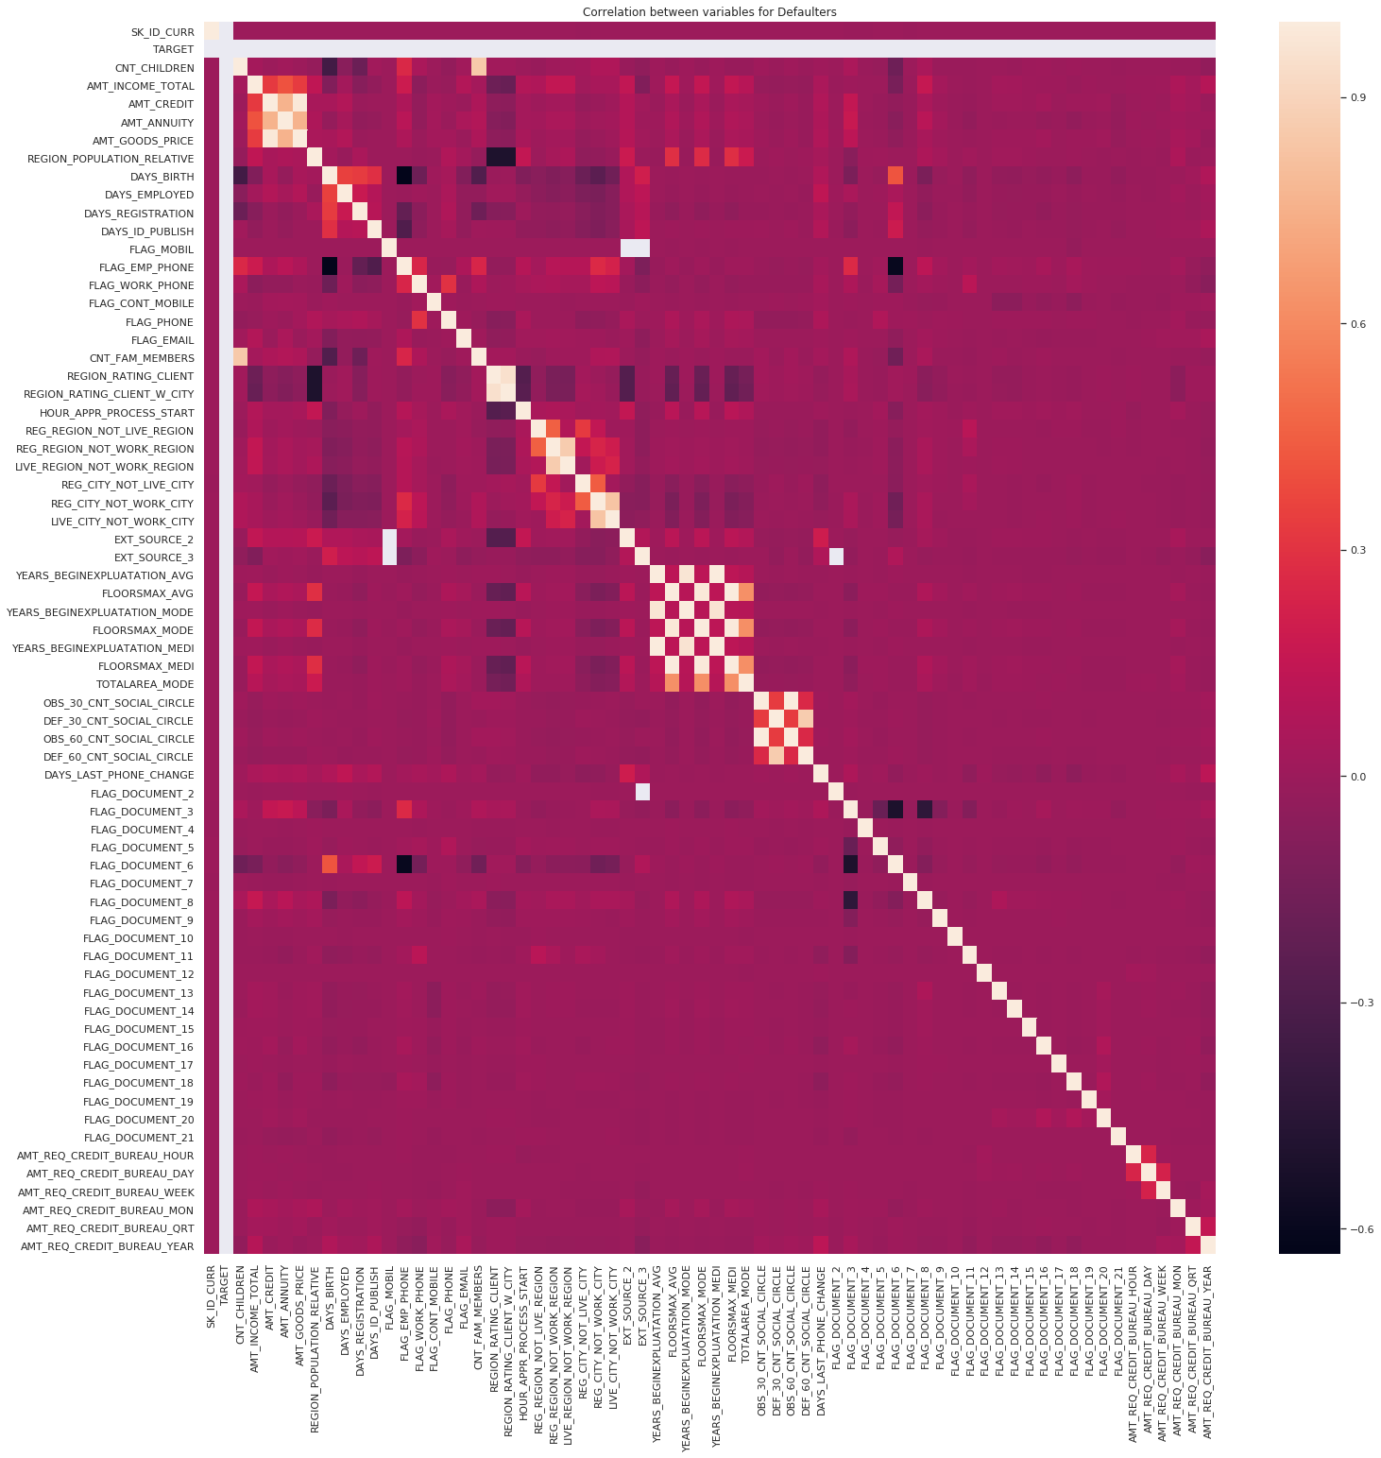
Negative correlation
Top 10 list of negative correlations between variables
Correlation diagram for Target = 1
Variable 1 | Variable 2 | Correlation for TARGET = 0 | Correlation for TARGET = 1
FLAG_EMP_PHONE | DAYS_BIRTH | -0.633631 | --0.586893
FLAG_DOCUMENT_6 | FLAG_EMP_PHONE | -0.600236 | -0.620202
FLAG_DOCUMENT_6I | FLAG_DOCUMENT_3 | -0.506959 | -0.489693
REGION_RATING_CLIENT_W_CITY | REGION_POPULATION_RELATIVE | -0.500267 | -0.427202
REGION_RATING_CLIENT | REGION_POPULATION_RELATIVE | -0.500259 | -0.422743
FLAG_DOCUMENT_8 | FLAG_DOCUMENT_3 | -0.431832 | -0.512800
CNT_CHILDREN | DAYS_BIRTH | -0.351201 | -0.272549
FLAG_EMP_PHONE | DAYS_ID_PUBLISH | -0.290013
CNT_FAM_MEMBERS | DAYS_BIRTH | -0.288651
HOUR_APPR_PROCESS_START | REGION_RATING_CLIENT | -0.275983 | -0.293270
REGION_RATING_CLIENT_W_CITY | HOUR_APPR_PROCESS_START |  | -0.275582
EXT_SOURCE_2 | REGION_RATING_CLIENT |  | -0.240792
Top 10 correlations between variables are in the range of (-0.275) to (-0.999). and both datasets(defaulter and non-defaulter) have similar correlation.
Below their combinations of variables have higher negative correlation for defaulter dataset compared to the non-defaulter dataset
DAYS_EMPLOYED & FLAG_DOCUMENT_3 -0.282129
HOUR_APPR_PROCESS_START & REGION_RATING_CLIENT_W_CITY -0.275582

Slide 8
Segmented univariate analysis
Below are few observations from segmented univariate analysis done on Family status, Housing Type, Profession,
Loan defaults are proportion is less for Married people compare to non-defaulters
For Single/Civil Married customers, the loan defaulter proportion is little higher than the non defaulters.
Its seems customer living with Parents have little more proportion of defaulting compared to non-defaulters
Similarly Municipal and Rented apartment accommodation shows slightly higher proportion towards defaulting
Customers who are currently working have higher proportion of defaulters
Pensioners seems to be pay back loan , so their proportion is less on defaulters
State servants are comparatively show less tendency towards defaulting

Slide 9
Segmented univariate analysis
Below are few observations from segmented univariate analysis done on Employment status and education variables.
Customers with profession as Laborer have higher proportion of defaulters
Another observation is as IT/HR staff have lower proportion of defaulting
Customers with Secondary education have high proportion of defaulting if compared to non-defaulters
Customers with higher education tend to default less as their proportion is reduced

Slide 10
Univariate analysis
From univariate analysis on income, annuity, Loan amount, age and region population fields, below are few insights:
The income of the customers seems to have similar distribution for both defaulters and non-defaulters
The Average income seems to be around 140K for both segments
For Annuity data The defaulters seems to have more outliers compared to non-defaulters
The average annuity is similar for both defaulters and non defaulters around 30K
for Loan amt. the defaulters seems to have more outliers compared to non-defaulters
The higher fence value for defaulters is around 1.2 M compared to non-defaulters which is around 1.5M
Large no of defaulters have credit of between 200K to 600K

Slide 11
Univariate analysis
From univariate analysis on income, annuity, Loan amount, age and region population fields, below are few insights:
It seems majority of defaulter are from low populated area, we can see that proportions for 0.05 and 0.07 are lower than that of non-defaulters
The median age for defaulters are around 14000 days older which would be around 40 Years
It looks like as the age increases proportion of defaulters decreases
The younger customers seems to have higher proportion of defaulters

Slide 12
Bivariate analysis
DAYS_BIRTH and DAYS_EMPLOYED
The correlation between employment and loan amount for non defaulters is -0.0663 , but if we considered data for only non-retired applicants correlation is: 0.0818
The correlation between employment and loan amount for loan-defaulters is 0.0018 , but if we considered data for only non-retired applicants correlation is: 0.1124
for Payment defaulters (TARGET = 1) As age increases and days employed increases, the loan default shows reductions. So It might be case that younger people will short employment history tend to default more.
Also for loan defaulters, their is correlation between employment period and loan amount is around 0.1124 which is significantly more than non-defaulters. (This observation is only for non-retired applicants)
AMT_CREDIT and DAYS_EMPLOYED
for Payment defaulters (TARGET = 1) It seems that the credit amount of loan is low at higher experience level. Also the loan default is concentrated below 1.5M Loan amount credit and below 10000 days (around 30 Years job experience)

Slide 13
Bivariate analysis
AMT_CREDIT and AMT_GOODS_PRICE
The correlation between property price and loan amount for non defaulters is 0.9816 but for defaulters it is: 0.9776
credit amount and goods price are highly correlated variables for both defaulters and non - defaulters. So as the home price increases the loan amount also increases
AMT_CREDIT and AMT_ANNUITY
The correlation between AMT_ANNUITY (EMI) and loan amount for non defaulters is 0.7609 but for defaulters it is: 0.7401
credit amount and AMT_ANNUITY (EMI) are highly correlated variables for both defaulters and non - defaulters . So as the home price increases the EMI amount also increases which is logical
AMT_ANNUITY and AMT_GOODS_PRICE
The correlation between DAYS_EMPLOYED (employment) and loan amount for non defaulters is 0.7604 but for defaulters it is: 0.7374
All three variables AMT_CREDIT, AMT_GOODS_PRICE and AMT_ANNUITY are highly correlated for both defaulters and non-defaulters, which might not give a good indicator for defaulter detection

Slide 14
Previous application data analysis
The previously refused % of applications for non-defaulters is: 16.75
The previously refused % of applications for defaulters is: 23.96
Its seems that for TARGET = 1 clients have larger proportion of previously Refused applications
Its seems that for defaulters more of the previous applications were for cash loans
in case of non-defaulters the consumer loans and cash loan proportion is similar
Its seems that for defaulters mean time of previous applications closed was smaller than that of non-defaulters
for defaulters have previous loan duration smaller than that of non-defaulters

Slide 15
Previous application data analysis
Bivariate analysis of AMT_CREDIT_y and AMT_APPLICATION
The previous application amount and credit amounts are show positive correlation around 0.97 Also it seems that previous application amount and current application amount have weak positive correlation of 0.092 for non-defaulters and 0.095 for defaulters

Slide 16
Thank You

